Slide 1
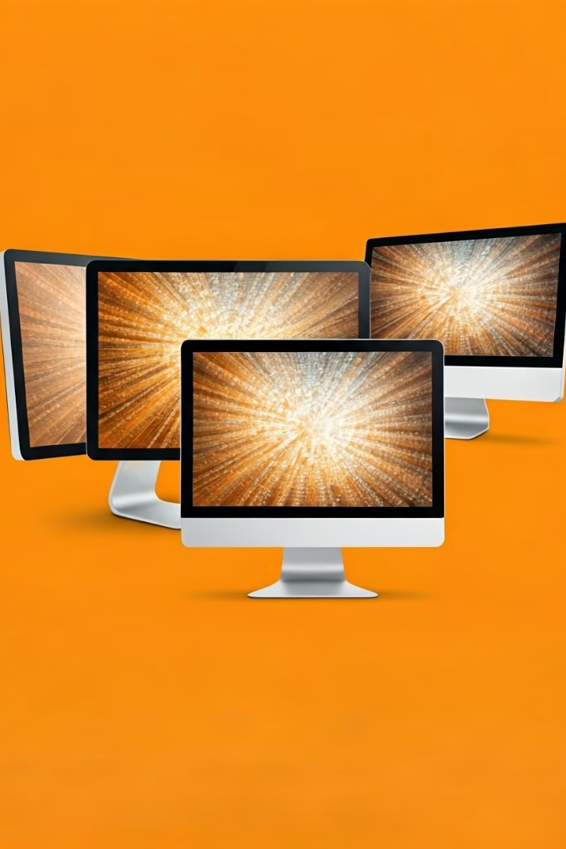

How Monitors Work:
LCD vs LED vs Touchscreen
A monitor is the screen of your computer where you see everything – like text, images, and videos. There are different types of monitors, such as LCD, LED, and Touchscreen.
by Ram N Java

Slide 2
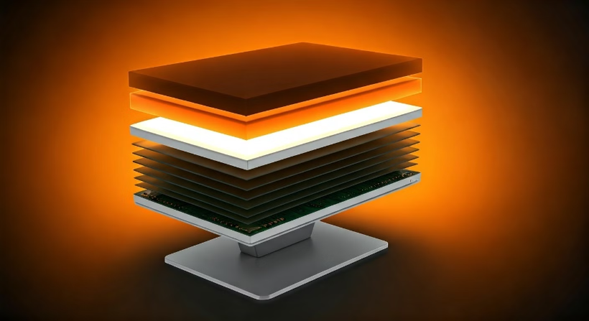
LCD Monitors (Liquid Crystal Display)
What is it?
An LCD monitor uses liquid crystals to create images on the screen. These crystals don't produce their own light, so the monitor needs a backlight to make the images visible.
How Does It Work?
The liquid crystals are sandwiched between two layers of glass.
When electricity passes through the crystals, they twist and block or allow light to pass through.
A backlight (usually fluorescent) shines through the crystals to create the image you see.

Slide 3
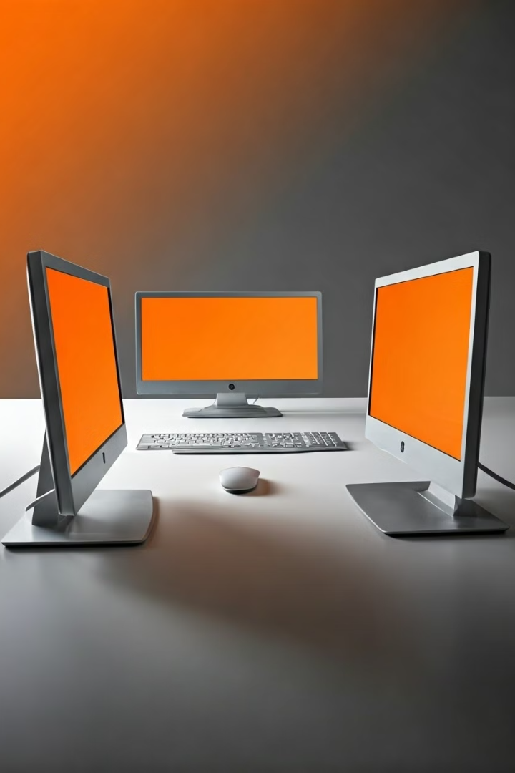
LCD Monitors (Liquid Crystal Display)
Pros
Thin and Light: LCD monitors are slim and easy to carry.
Energy Efficient: They use less power than older monitors (like CRT).
Good Image Quality: They produce clear and sharp images.
Cons
Limited Viewing Angles: The image may look less clear if you view it from the side.
Slower Response Time: Not ideal for fast-moving images (like gaming).

Slide 4
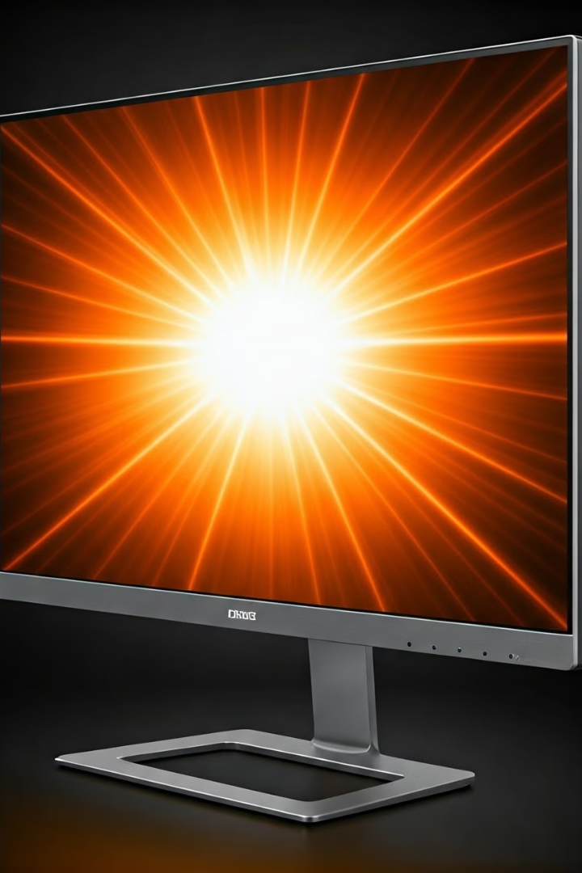
LED Monitors (Light Emitting Diode)
What is it?
How Does It Work?
An LED monitor is a type of LCD monitor, but it uses LEDs (tiny light bulbs) for the backlight instead of fluorescent lights. This makes it brighter and more energy-efficient.
Like LCD monitors, it uses liquid crystals to create images.
Backlight Technology
LED Placement
Instead of a fluorescent backlight, it uses LEDs to light up the screen.
The LEDs can be placed either around the edges (edge-lit) or behind the screen (full-array).

Slide 5





LED Monitors (Light Emitting Diode)
Brighter and Clearer
More Energy Efficient
Thinner Design
LEDs produce brighter and more vibrant colors.
They use less power than LCD monitors.
LED monitors are even thinner than LCD monitors.
More Expensive
Edge-Lit Issues
LED monitors usually cost more than
LCD monitors.
Edge-lit LEDs may have uneven brightness.

Slide 6
Touchscreen Monitors
Touchscreen Monitor
Sensitive Layer
Two Main Types
Lets you touch the screen to give commands
Detects your touch and sends signals
Resistive (pressure) and Capacitive (electrical charge)
A touchscreen monitor lets you touch the screen to give commands, just like a smartphone or tablet. The screen has a sensitive layer that detects your touch. When you touch the screen, it sends a signal to the computer to perform an action.
There are two main types of touchscreens:
Resistive: Works by pressure (you can use a finger or stylus).
Capacitive: Works by sensing the electrical charge from your finger.

Slide 7






Touchscreen Monitors
Easy to Use
Great for Portability
No Need for Mouse
You can directly interact with the screen.
Often used in tablets, smartphones, and
all-in-one computers.
You can tap, swipe, or pinch to control the computer.
More Expensive
Fingerprints
Less Durable
Touchscreen monitors cost more than regular monitors.
The screen can get smudged easily.
The screen may scratch or break if not handled carefully.

Slide 8

Comparison Table
Feature
LCD Monitor
LED Monitor
Touchscreen Monitor
Backlight
Fluorescent light.
LEDs (brighter and more efficient).
LEDs or other backlight.
Image Quality
Good, but less vibrant than LED.
Bright and vibrant colors.
Depends on the underlying technology (LCD/LED).
Energy Use
Less efficient than LED.
More energy efficient.
Similar to LCD/LED, but touch adds some power use.
Cost
Cheaper than LED.
More expensive than LCD.
Most expensive due to touch feature.
Best For
Basic tasks, office work.
General use, gaming, movies.
Interactive tasks, tablets, all-in-one PCs.

Slide 9

Which One Should You Choose?
Choose an LCD Monitor
If you want a budget-friendly option for basic tasks like browsing or office work.
Choose an LED Monitor
If you want better image quality and energy efficiency for gaming, movies, or general use.
Choose a Touchscreen Monitor
If you want to interact directly with the screen, like on a tablet or all-in-one computer.

Slide 10






Summary
LED Monitors
Use liquid crystals and an
LED backlight. Brighter and more energy-efficient.
LCD Monitors
Use liquid crystals and a fluorescent backlight. Good for basic tasks.
Touchscreen Monitors
Let you touch the screen to control the computer. Great for interactive tasks.
Choose the monitor that fits your needs and budget!

